Slide 1

Note: The data and information in this document is reflective of a hypothetical situation and client. This document is to be used for KPMG Virtual Internship purposes only.
Sprocket Central Pty Ltd
Data analytics approach
[Division Name] - [Engagement Manager], [Senior Consultant], [Junior Consultant]

Slide 2
Note: The data and information in this document is reflective of a hypothetical situation and client. This document is to be used for KPMG Virtual Internship purposes only.
Agenda
Introduction
Project Recap
Problem Statement
The Analytics Team
Analysis Process
Key Insights and Findings
Recommendations
Conclusion

Slide 3
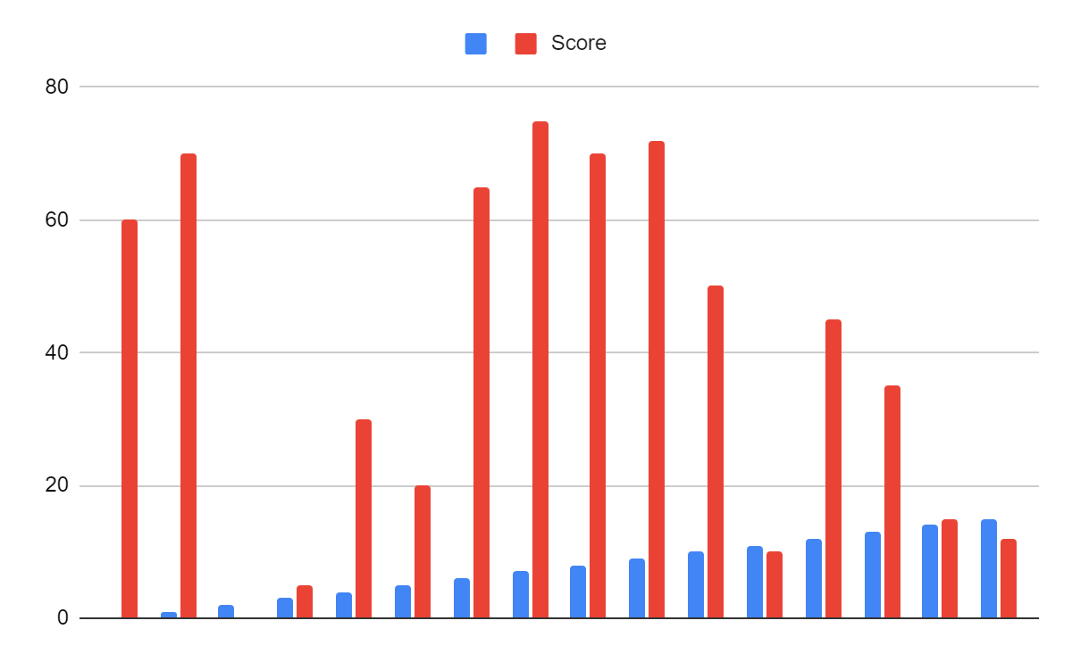
Note: The data and information in this document is reflective of a hypothetical situation and client. This document is to be used for KPMG Virtual Internship purposes only.
Introduction
Social Buzz, a leading social media and content creation company, has reached significant growth in recent years, and our team has been tasked with uncovering valuable insights to drive their business strategy.
Throughout this presentation, we will delve into our analysis process, key findings, and actionable recommendations based on data-driven insights.
Let's explore how understanding content popularity can help Social Buzz optimize their offerings, engage users, and stay ahead in the dynamic social media landscape.

Slide 4
Note: The data and information in this document is reflective of a hypothetical situation and client. This document is to be used for KPMG Virtual Internship purposes only.
Project Recap
Client: Social Buzz
Industry: Social media and content creation
Background: Founded in 2010 by former engineers from a social media conglomerate
Rapid growth and need for external expertise
Project Scope: Initial 3-month engagement
Objectives: Audit of big data practice, IPO recommendations, analysis of content categories

Slide 5
Note: The data and information in this document is reflective of a hypothetical situation and client. This document is to be used for KPMG Virtual Internship purposes only.
Problem Statement
The client, Social Buzz, wants to gain insights into the popularity of content categories on their platform.
Understanding the most popular categories is crucial for their business strategy and decision-making.
By leveraging data analysis, we aim to identify the top 5 content categories with the highest popularity.
This analysis will enable Social Buzz to optimize their platform and provide targeted recommendations to content creators."

Slide 6
Note: The data and information in this document is reflective of a hypothetical situation and client. This document is to be used for KPMG Virtual Internship purposes only.
The analysis Team
Andrew Fleming - Chief Technical Architect
Marcus Rompton - Senior Principle
Gopika sucharitha - Data Analyst
Expertise in data analysis, modeling, and visualization
Collaborative team approach to deliver insights

Slide 7
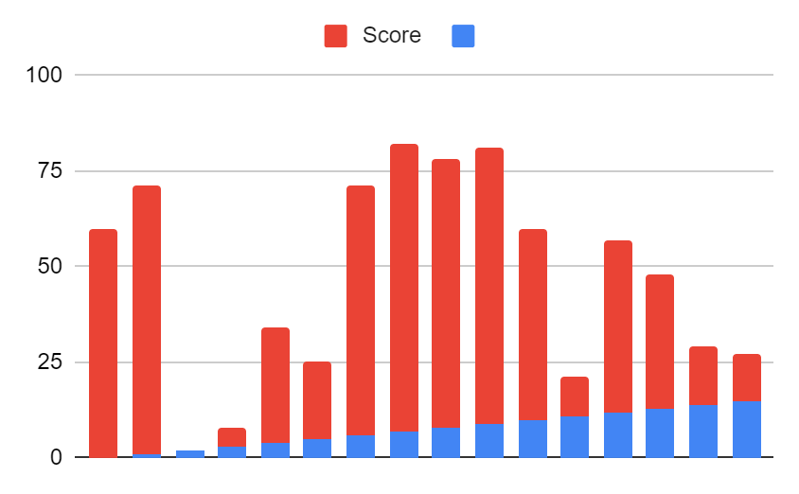
Note: The data and information in this document is reflective of a hypothetical situation and client. This document is to be used for KPMG Virtual Internship purposes only.
Analysis Process
Requirements gathering: Identified relevant data sets (Reaction, Content, Reaction Types)
Data cleaning: Ensured data quality and consistency
Data modeling: Utilized data model to establish relationships between data sets
Data analysis: Aggregated scores by content category to determine popularity
Data visualization: Created visualizations to represent insights effectively
Data storytelling: Developed a narrative to present insights in a compelling manner

Slide 8
Note: The data and information in this document is reflective of a hypothetical situation and client. This document is to be used for KPMG Virtual Internship purposes only.
Key Insights and Findings
Overview of the top 5 content categories with the largest popularity
Visual representations of the popularity scores and trends
Comparison of different content types within the top categories
Identification of potential opportunities and areas for improvement

Slide 9
Note: The data and information in this document is reflective of a hypothetical situation and client. This document is to be used for KPMG Virtual Internship purposes only.
Recommendation
Actionable recommendations based on the insights
Strategies to capitalize on popular content categories
Suggestions for content optimization and user engagement
Considerations for future decision-making and growth

Slide 10
Note: The data and information in this document is reflective of a hypothetical situation and client. This document is to be used for KPMG Virtual Internship purposes only.
Conclusion
Summary of the analysis process and key findings
Emphasize the value of data-driven insights for Social Buzz
Appreciation for the opportunity to work on the project
Open for questions and further discussion

